Slide 1


Google Machine Learning courses
Notes:
https://developers.google.com/machine-learning/crash-course

Slide 2
What you will learn
Linear Regression
Logistic Regression
Classification
Working with Numerical Data
Working with Categorical Data
Datasets, Generalization, and Overfitting
Neural Networks
Embeddings
Large Language Models
Production ML Systems
AutoML
ML Fairness

Slide 3
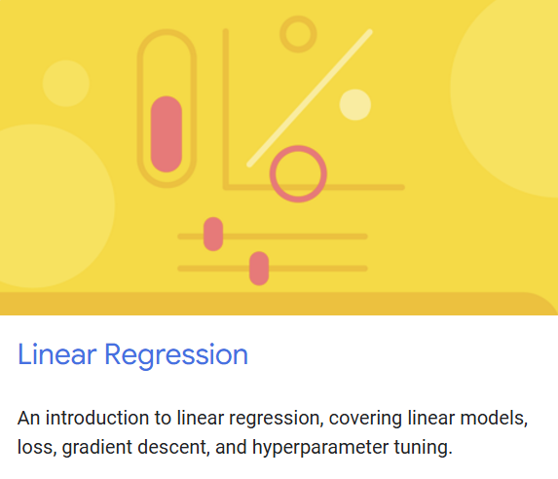
Linear regression
Notes:
https://developers.google.com/machine-learning/crash-course/linear-regression

Slide 4
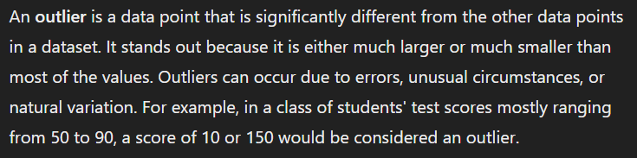

Slide 5
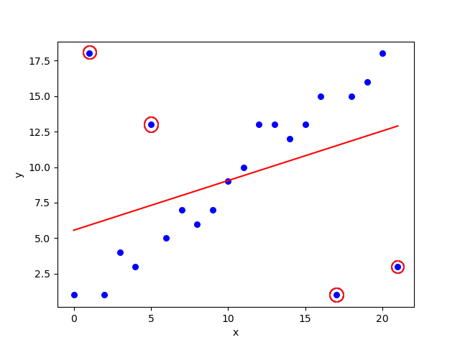

Slide 6
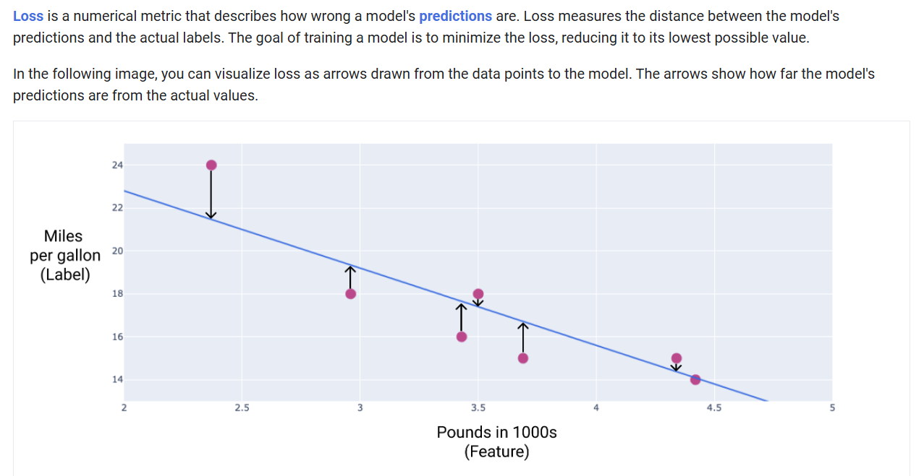
Notes:
https://developers.google.com/machine-learning/crash-course/linear-regression/loss

Slide 7
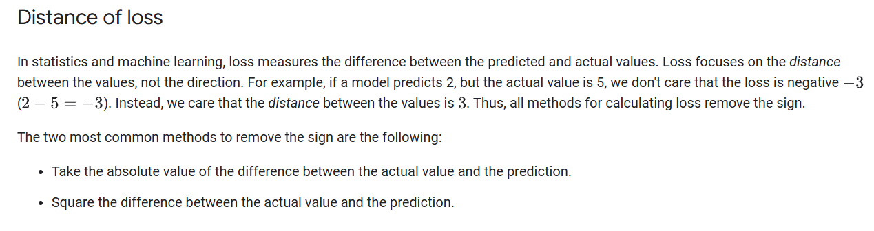

Slide 8
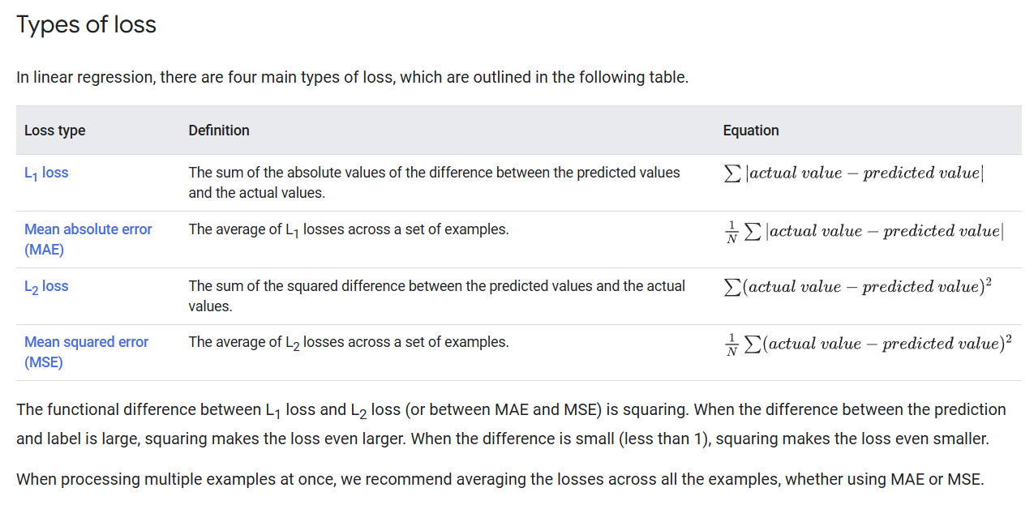

Slide 9
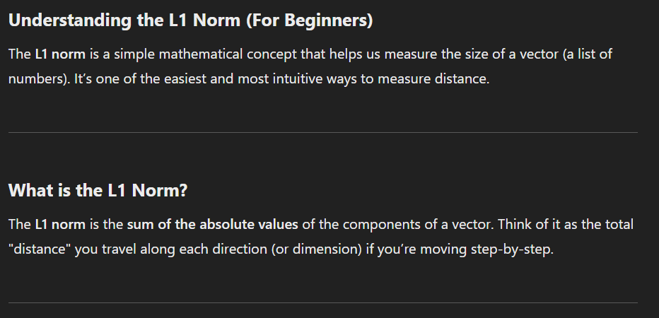

Slide 10
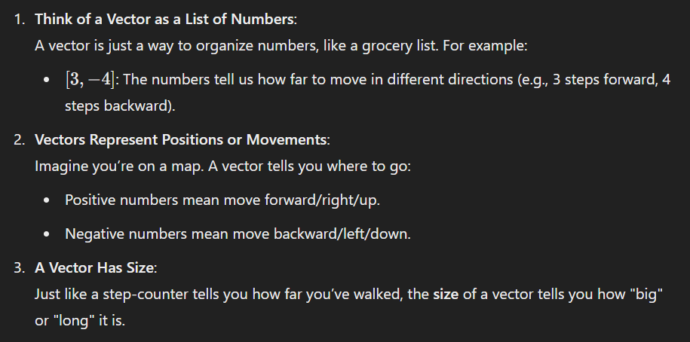

Slide 11
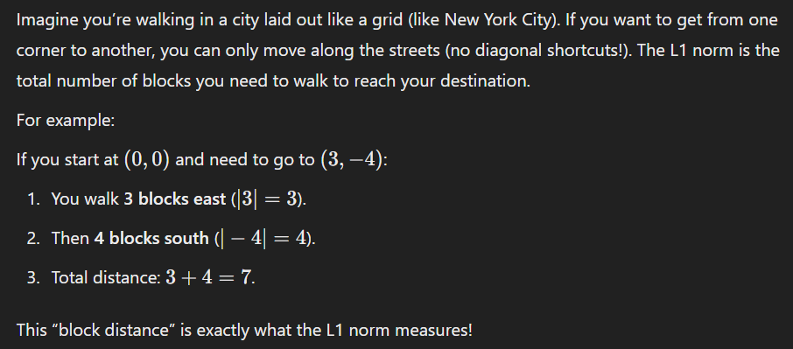

Slide 12
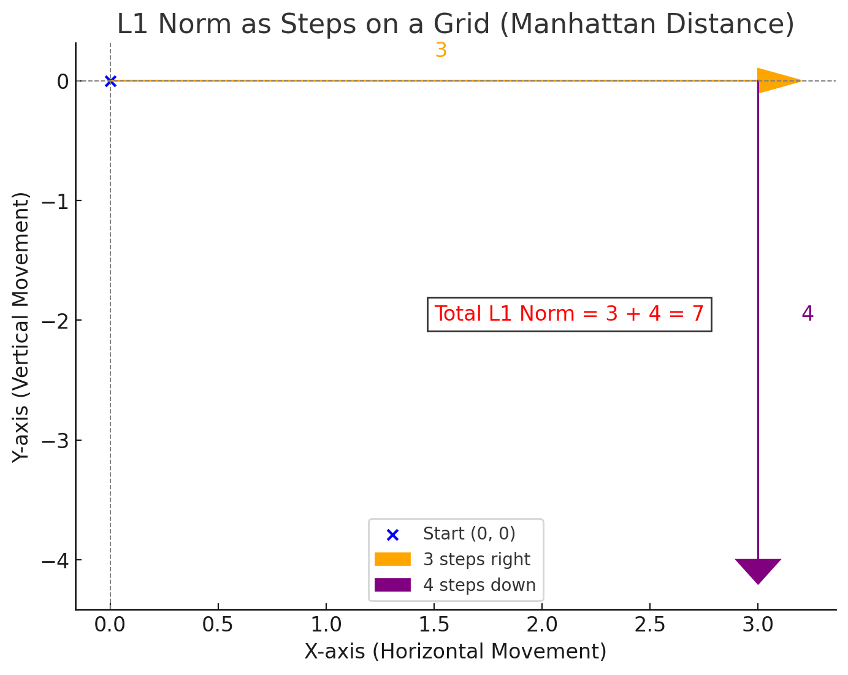

Slide 13
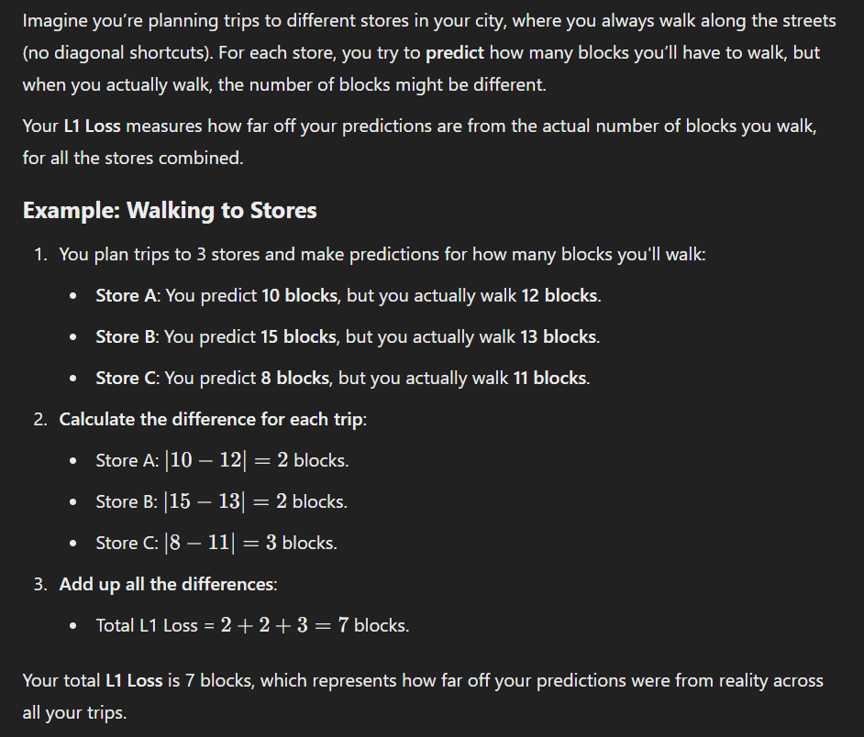

Slide 14
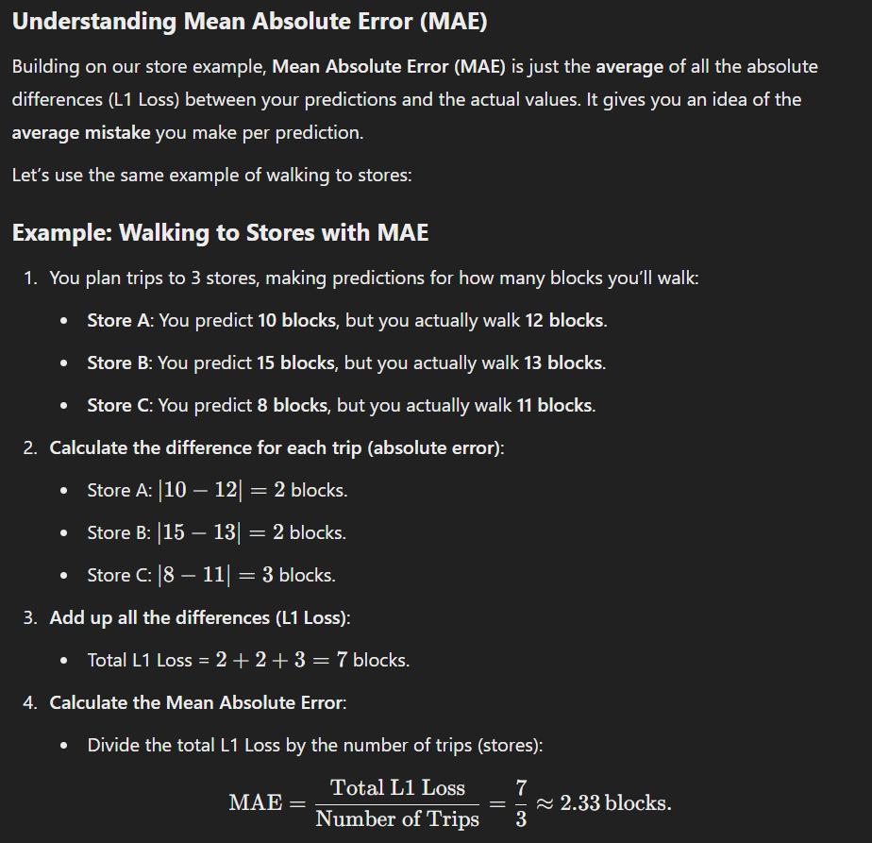

Slide 15
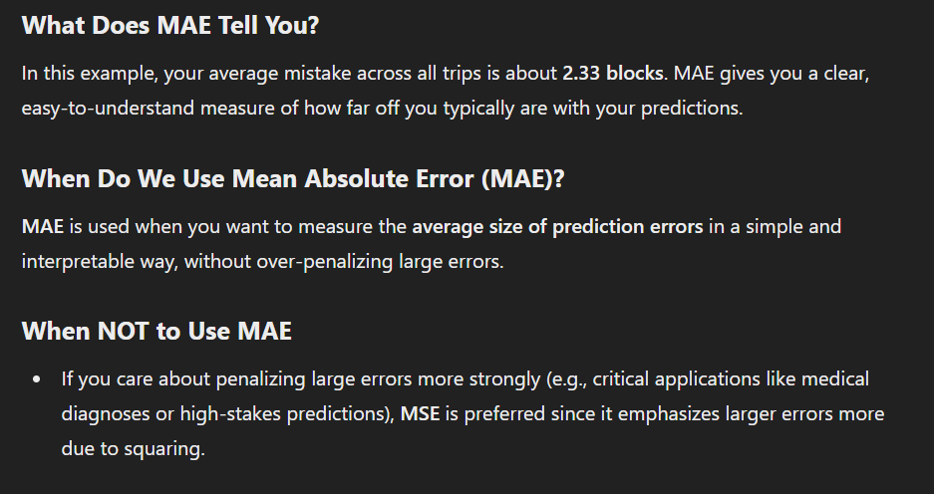

Slide 16
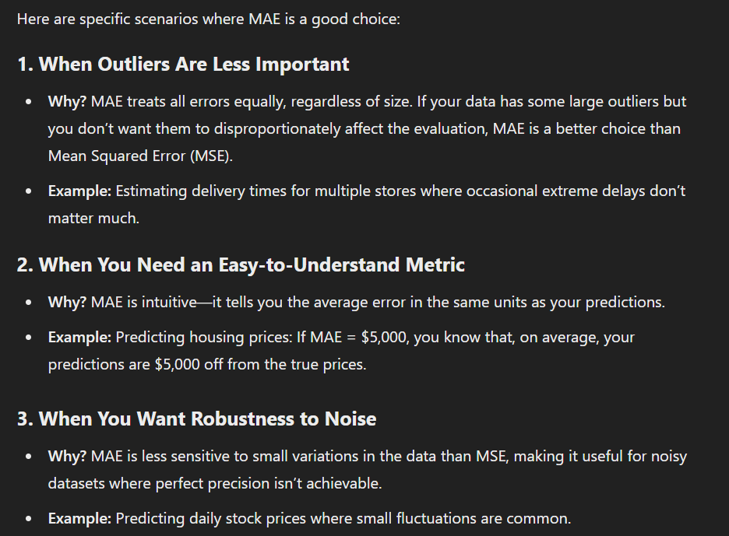

Slide 17




Notes:
https://www.youtube.com/channel/UC35ZpwldGw7ZJ5R-2sLijzw

Slide 18
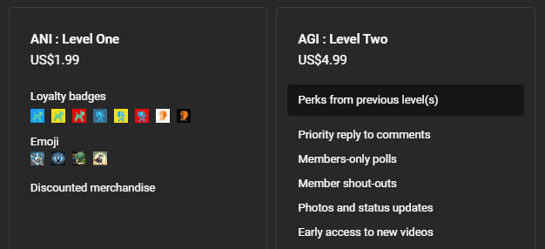

Membership has its privileges
Notes:
https://www.youtube.com/channel/UC35ZpwldGw7ZJ5R-2sLijzw/join

Slide 19

https://www.youtube.com/@AINewsFresh

Slide 20

https://www.youtube.com/@DailyAINewsPodcast

Slide 21

https://www.youtube.com/@AIPapersPodcastDaily

Slide 22
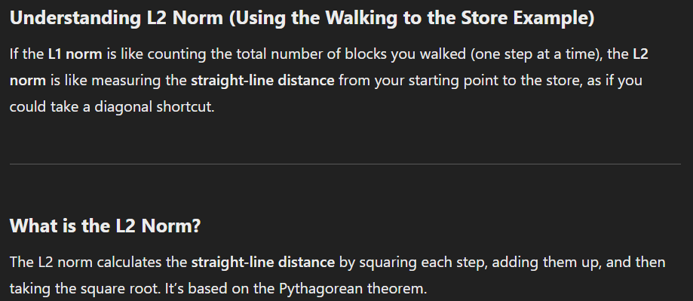

Slide 23
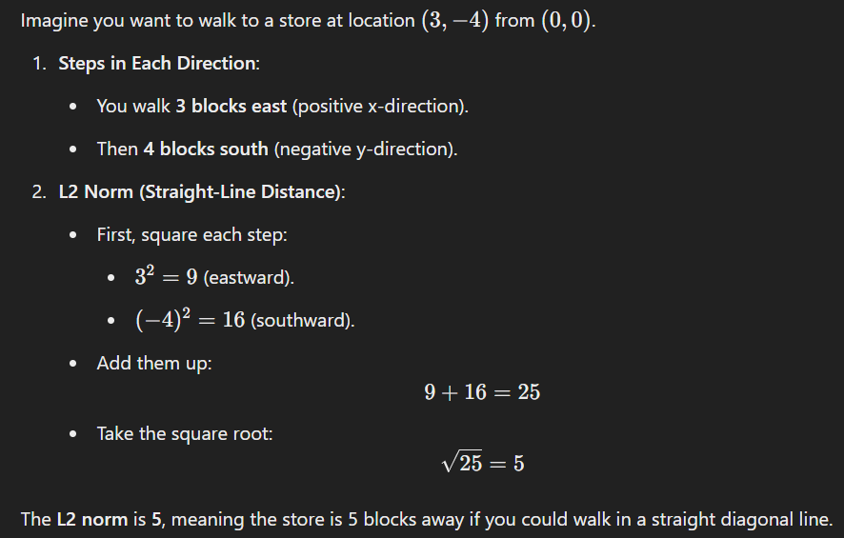

Slide 24
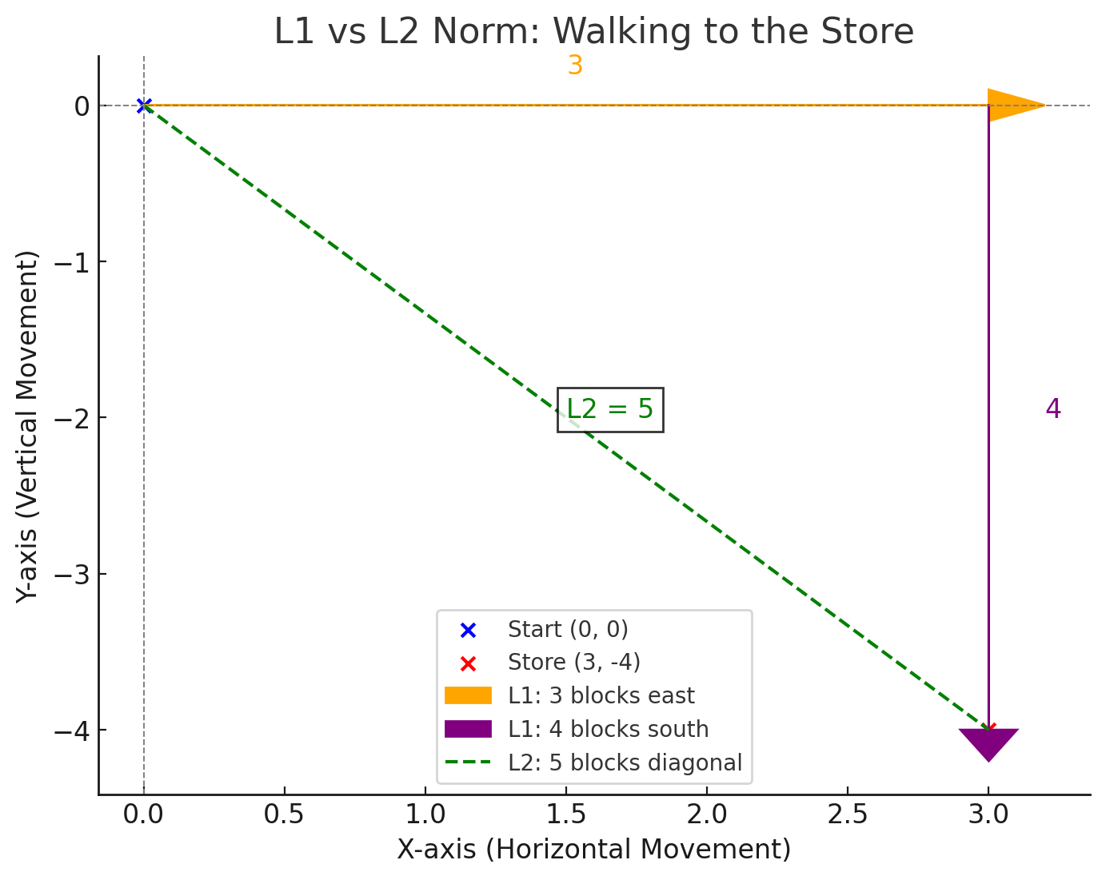

Slide 25
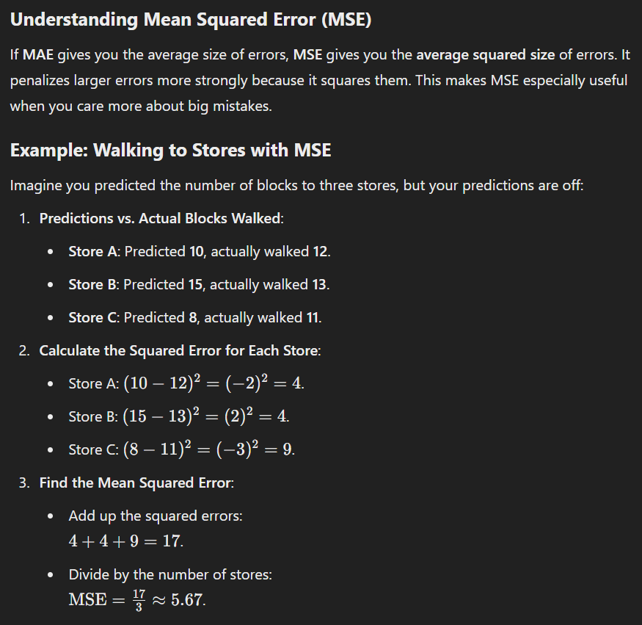

Slide 26
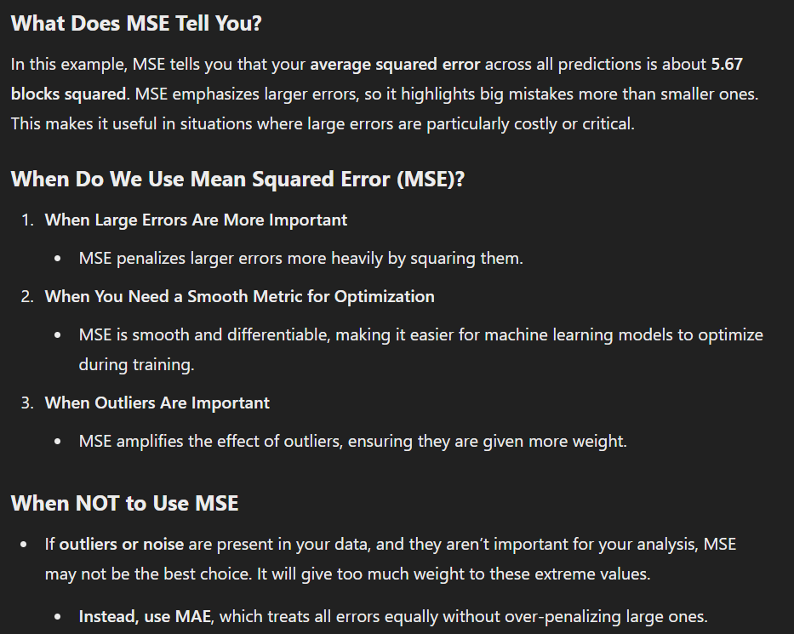

Slide 27
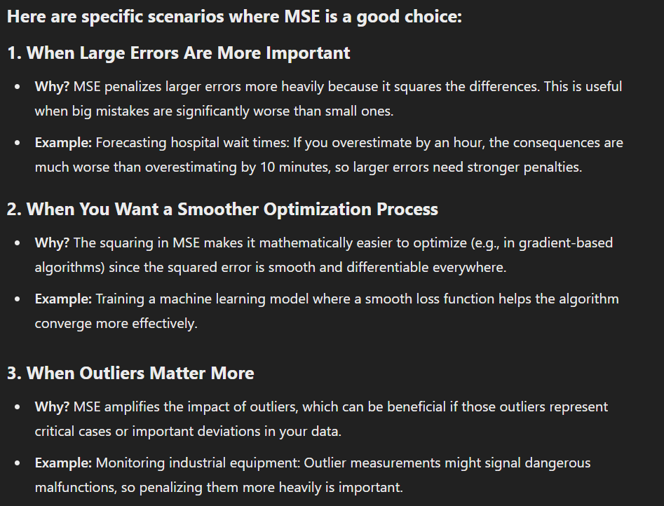

Slide 28
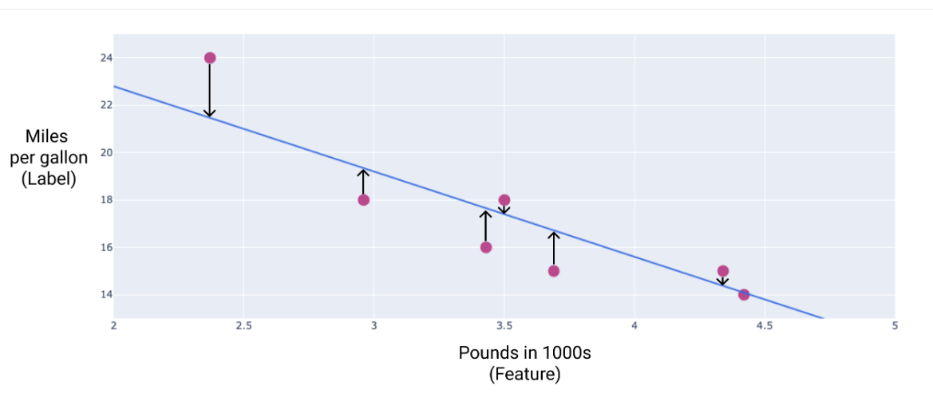

Slide 29
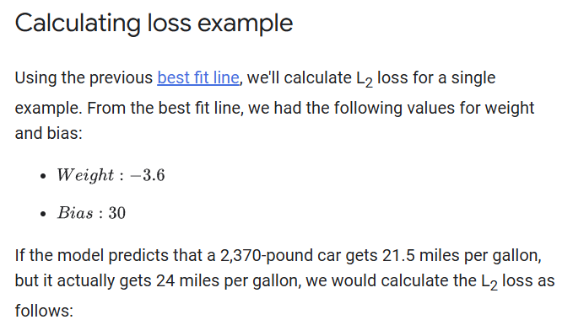

Slide 30
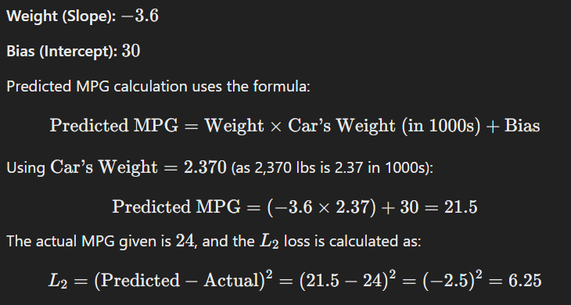

Slide 31
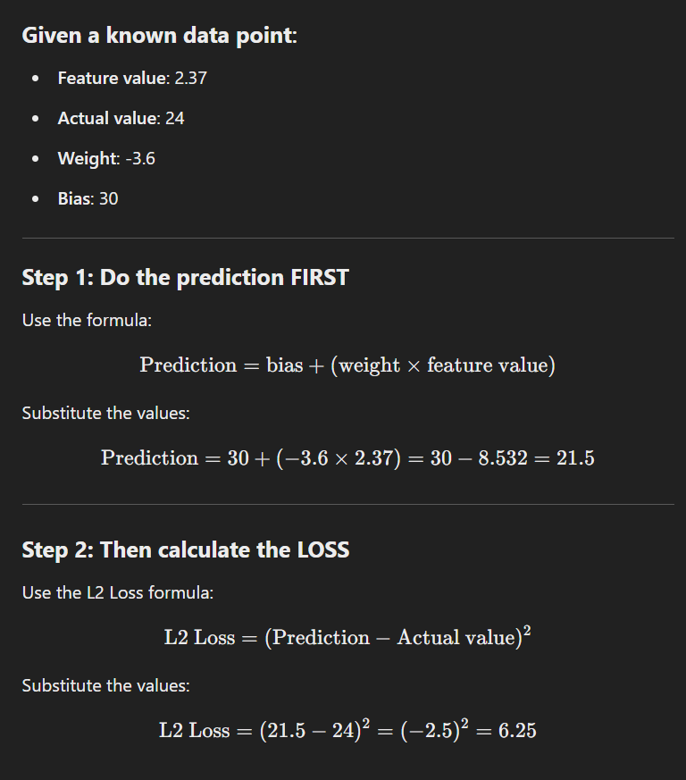

Slide 32
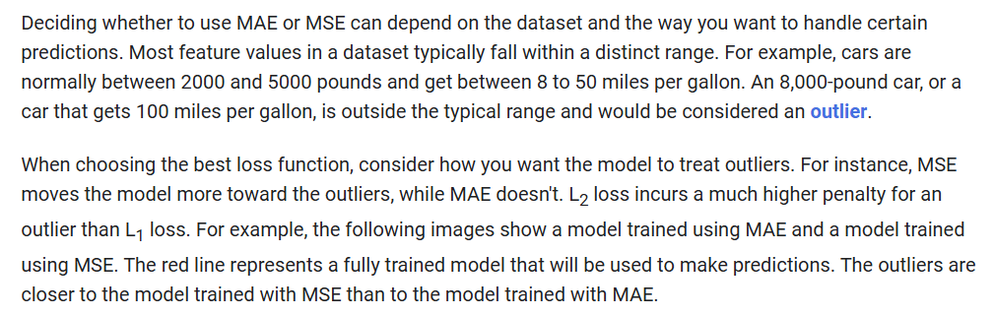

Slide 33
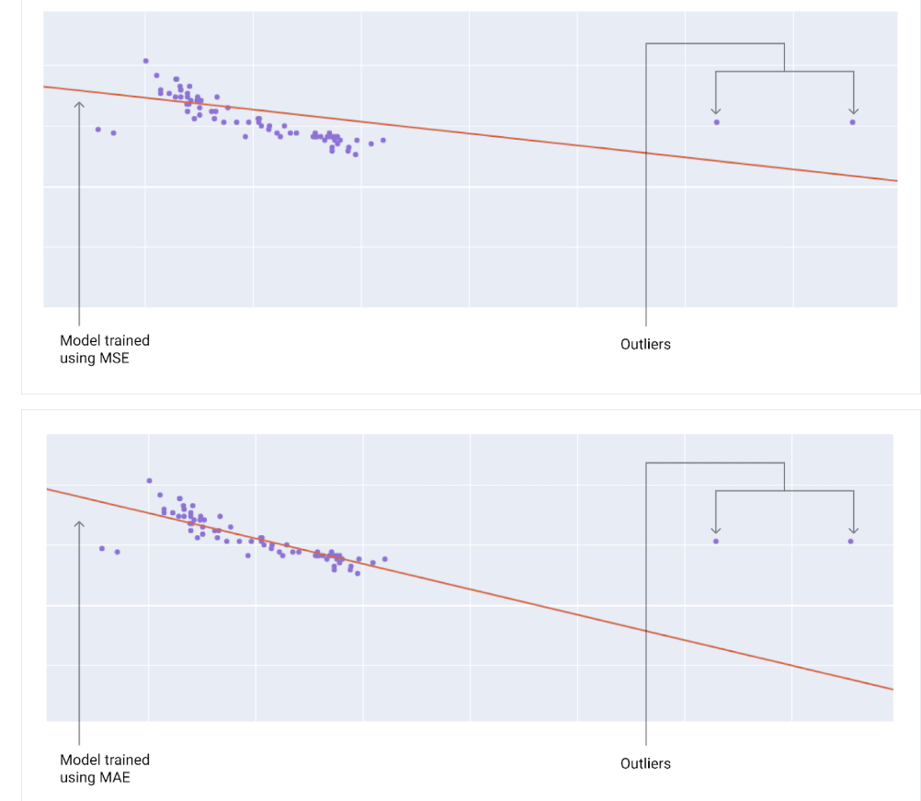

Slide 34
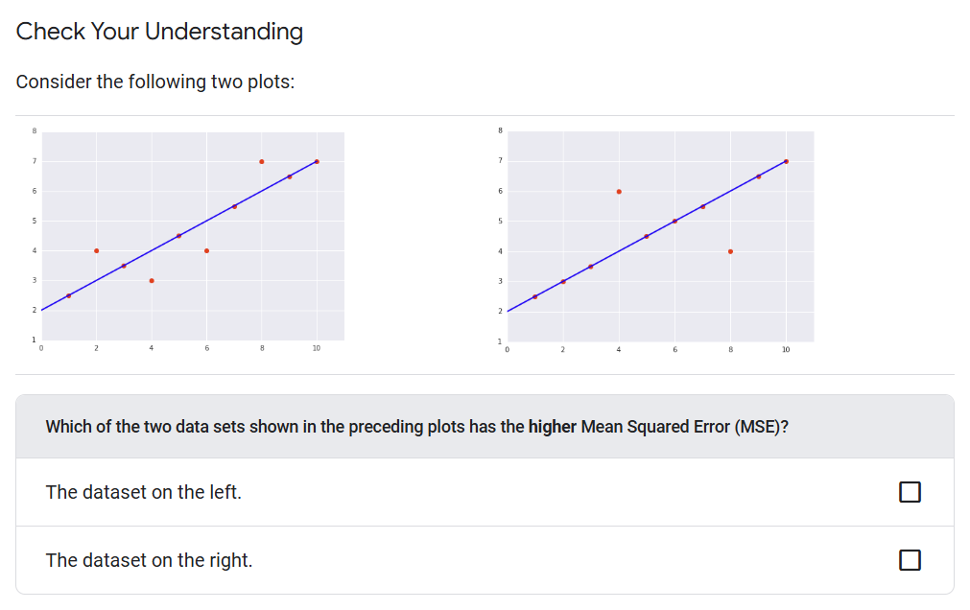

Slide 35
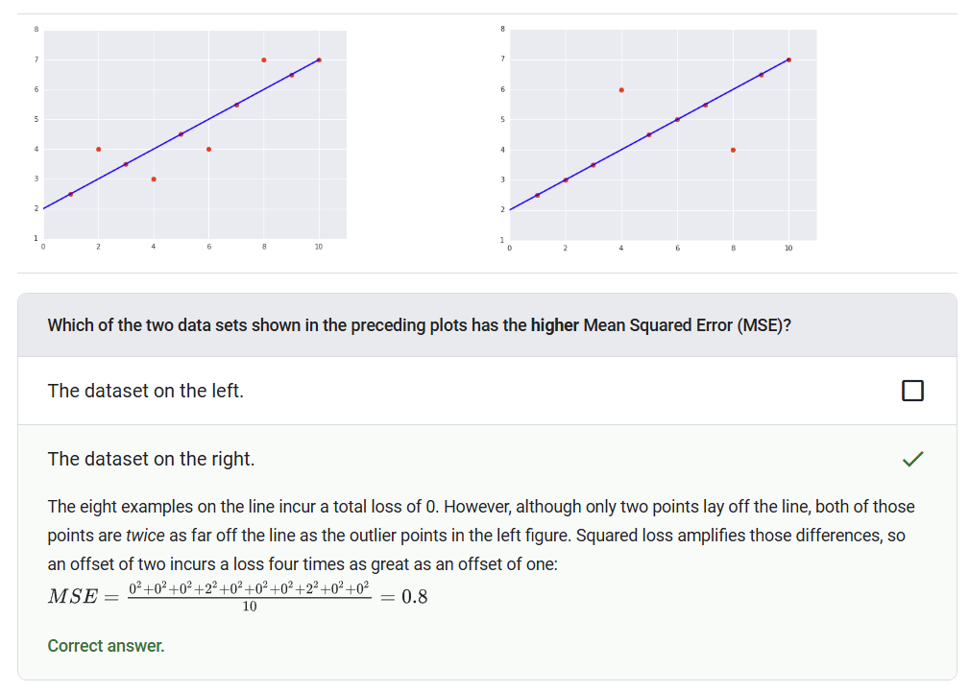

Slide 36
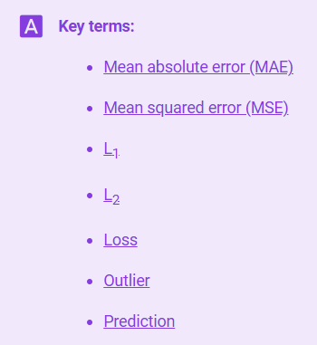
Notes:
https://developers.google.com/machine-learning/glossary

Slide 37
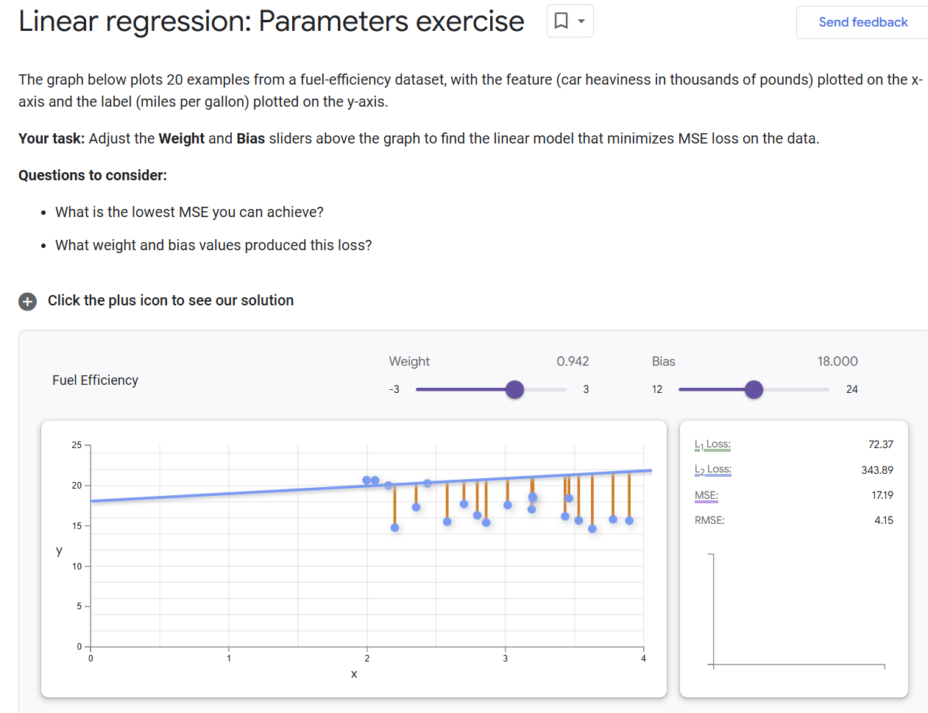
Notes:
https://developers.google.com/machine-learning/crash-course/linear-regression/parameters-exercise

Slide 38
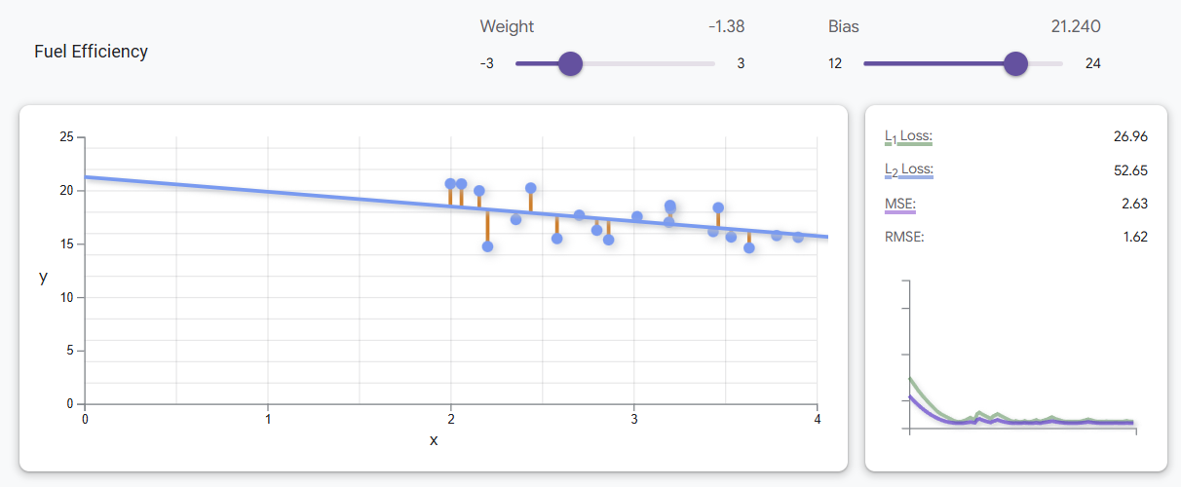

Slide 39


